Slide 1
MODEL TUNING

Slide 2
When we talk about the predictive model, we actually talk about how well it performs and its accuracy which is known as prediction errors.
A model is said to be a good machine learning model if it generalizes any new input data from the problem domain in a proper way.
This helps us to make predictions about future data.
Now, suppose we want to check how well our machine learning model learns and generalizes to the new data.
For that, we have overfitting and underfitting, which are majorly responsible for the poor performances of the machine learning algorithms.

Slide 3
Bias and Variance
Bias refers to the error due to overly simplistic assumptions in the learning algorithm.
These assumptions make the model easier to comprehend and learn but might not capture the underlying complexities of the data.
It is the error due to the model’s inability to represent the true relationship between input and output accurately.
When a model has poor performance both on the training and testing data means high bias because of the simple model, indicating underfitting.

Slide 4
Variance, on the other hand, is the error due to the model’s sensitivity to fluctuations in the training data.
It’s the variability of the model’s predictions for different instances of training data.
High variance occurs when a model learns the training data’s noise and random fluctuations rather than the underlying pattern.
As a result, the model performs well on the training data but poorly on the testing data, indicating overfitting.

Slide 5
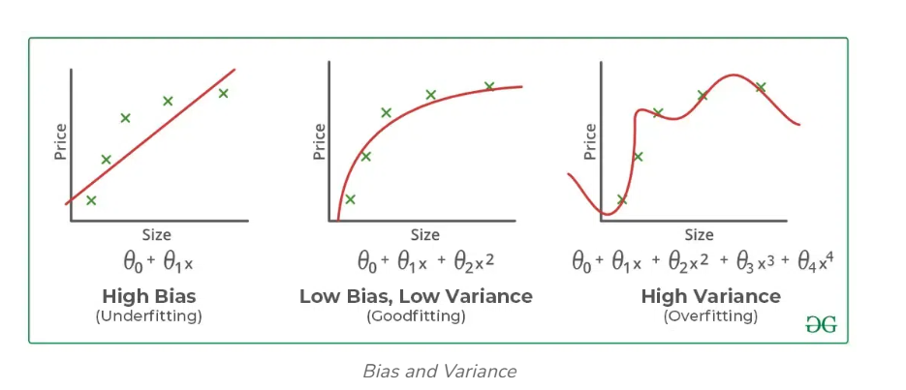

Slide 6
Underfitting in Machine Learning
A predictive model or a machine learning algorithm is said to have underfitting when a model is too simple to capture data complexities.
It represents the inability of the model to learn the training data effectively result in poor performance both on the training and testing data.
In simple terms, an underfit model’s are inaccurate, especially when applied to new, unseen examples.
It mainly happens when we uses very simple model with overly simplified assumptions.
To address underfitting problem of the model, we need to use more complex models, with enhanced feature representation, and less regularization.
Note: The underfitting model has High bias and low variance.

Slide 7
Reasons for Underfitting
The model is too simple, So it may be not capable to represent the complexities in the data.
The input features which is used to train the model is not the adequate representations of underlying factors influencing the target variable.
The size of the training dataset used is not enough.
Excessive regularization are used to prevent the overfitting, which constraint the model to capture the data well.
Features are not scaled.
Techniques to Reduce Underfitting
Increase model complexity.
Increase the number of features, performing feature engineering
Remove noise from the data.
Increase the number of epochs or increase the duration of training to get better results.

Slide 8
Overfitting in Machine Learning
A statistical model is said to be overfitted when the model does not make accurate predictions on testing data.
When a model gets trained with so much data, it starts learning from the noise and inaccurate data entries in our data set.
And when testing with test data results in High variance.
Then the model does not categorize the data correctly, because of too many details and noise.
The causes of overfitting are the non-parametric and non-linear methods.
Because these types of machine learning algorithms have more freedom in building the model based on the dataset and therefore they can really build unrealistic models.
A solution to avoid overfitting is using a linear algorithm if we have linear data or using the parameters like the maximal depth if we are using decision trees.

Slide 9
Reasons for Overfitting:
1.High variance and low bias.
The model is too complex.
The size of the training data.
Techniques to Reduce Overfitting
Improving the quality of training data reduces overfitting by focusing on meaningful patterns, mitigate the risk of fitting the noise or irrelevant features.
Increase the training data can improve the model’s ability to generalize to unseen data and reduce the likelihood of overfitting.
Reduce model complexity.
Early stopping during the training phase (have an eye over the loss over the training period as soon as loss begins to increase stop training).
Ridge Regularization and Lasso Regularization.

Slide 10
Good Fit in a Statistical Model
Ideally, the case when the model makes the predictions with 0 error, is said to have a good fit on the data.
This situation is achievable at a spot between overfitting and underfitting.
In order to understand it, we will have to look at the performance of our model with the passage of time, while it is learning from the training dataset.
With the passage of time, our model will keep on learning, and thus the error for the model on the training and testing data will keep on decreasing.
If it will learn for too long, the model will become more prone to overfitting due to the presence of noise and less useful details.
Hence the performance of our model will decrease.
In order to get a good fit, we will stop at a point just before where the error starts increasing.
At this point, the model is said to have good skills in training datasets as well as our unseen testing dataset.

Slide 11
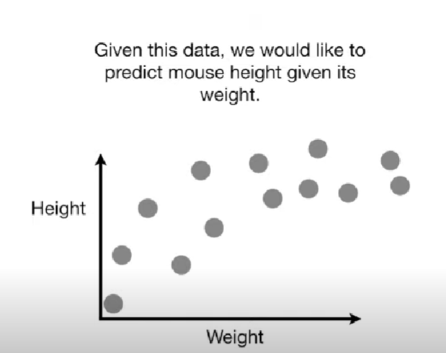
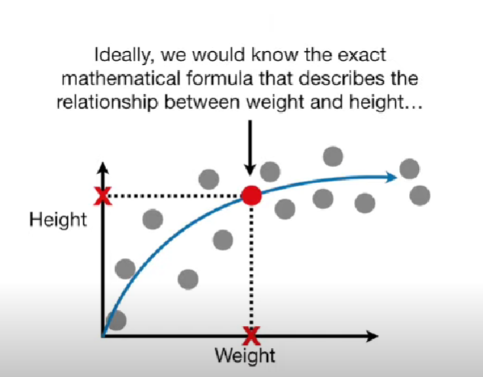

Slide 12
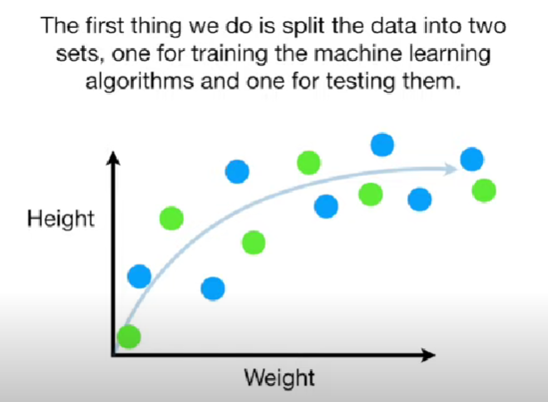
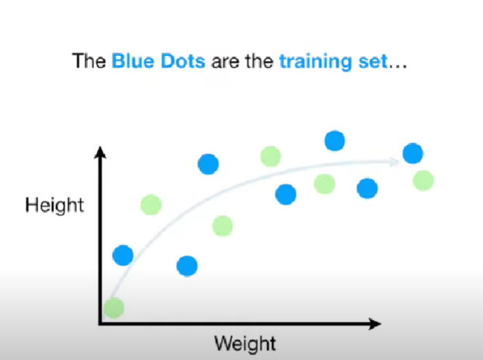
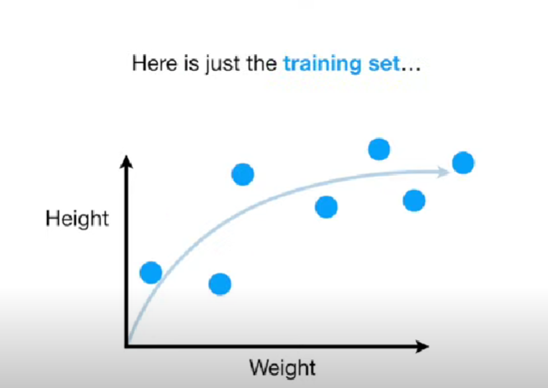
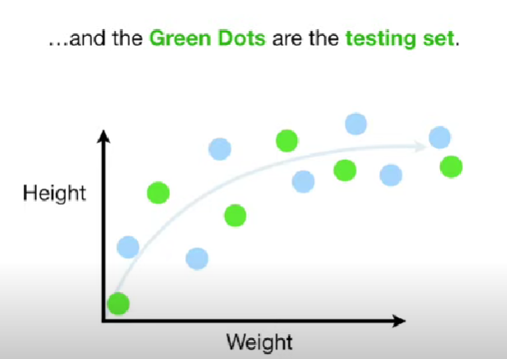

Slide 13
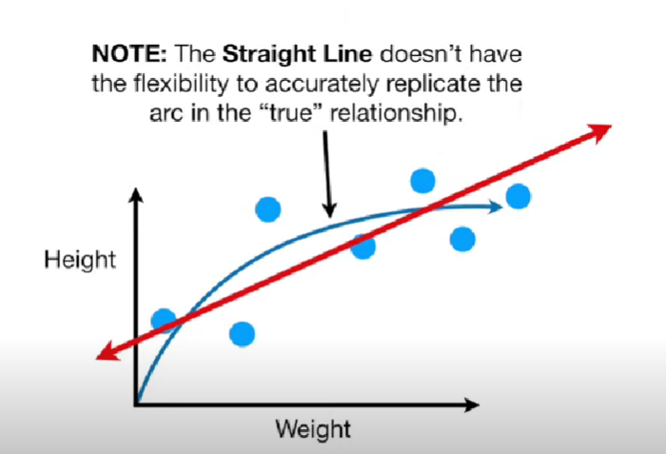
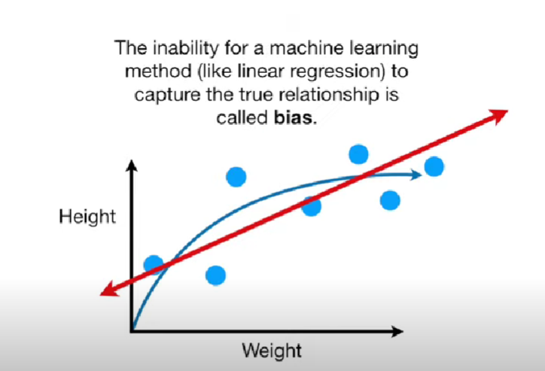

Slide 14
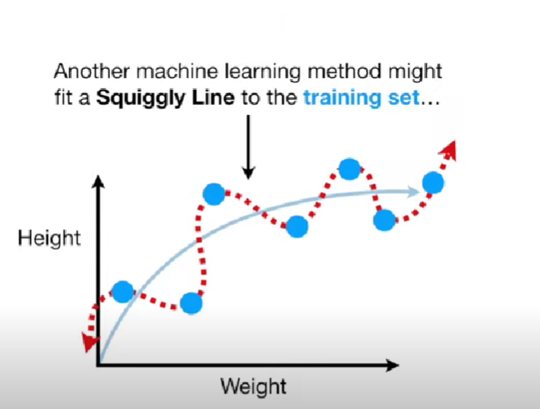
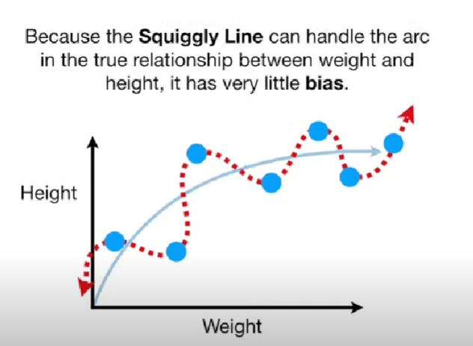

Slide 15
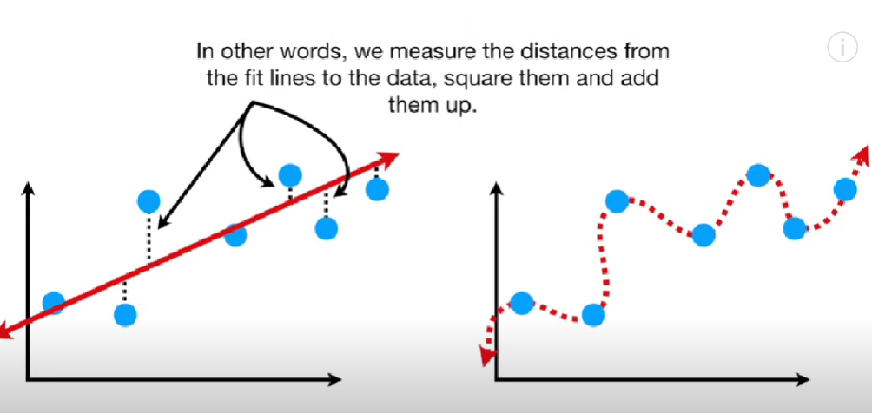

Slide 16
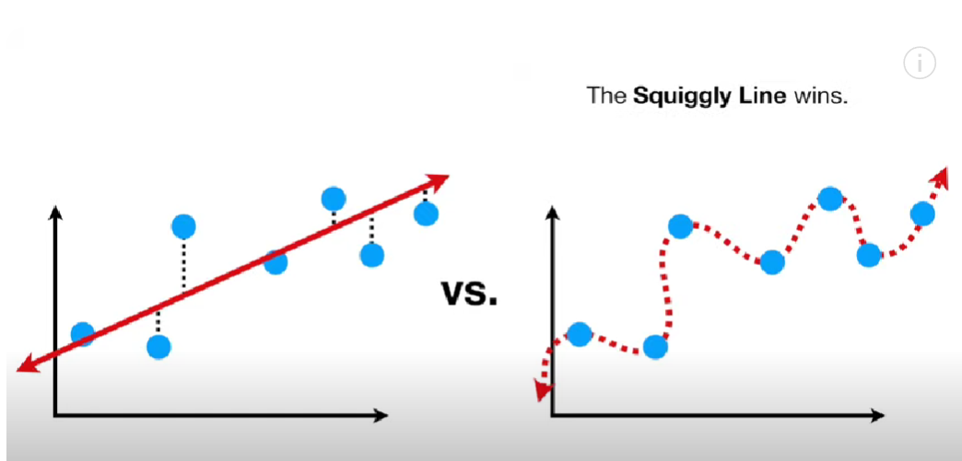

Slide 17
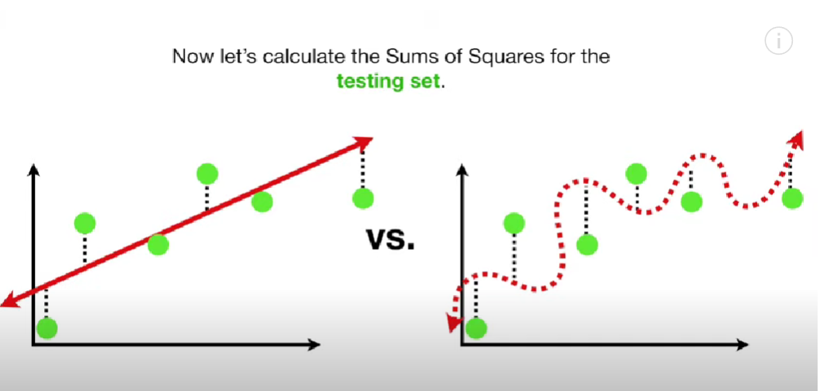

Slide 18
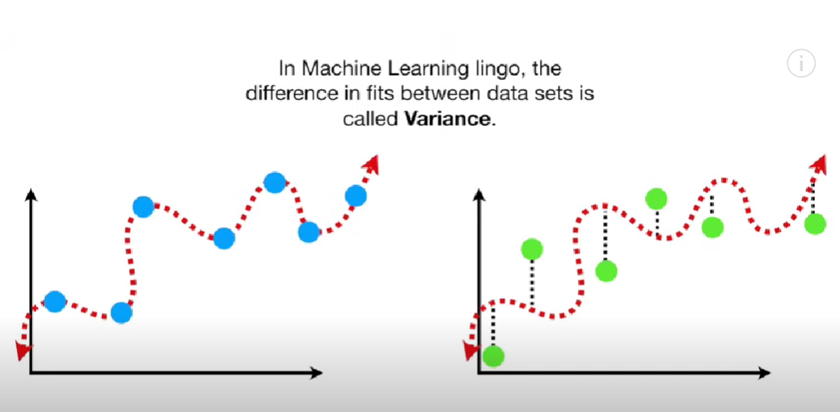

Slide 19
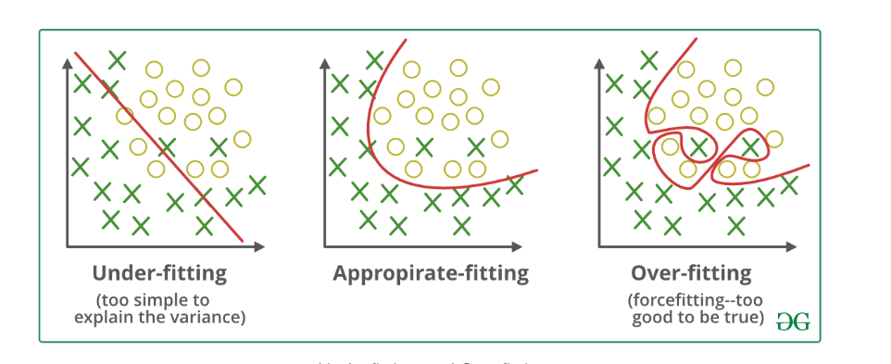

Slide 21
MODEL TUNING
Model tuning is the experimental process of finding the optimal values of hyperparameters to maximize model performance.
Hyperparameters in Machine learning are those parameters that are explicitly defined by the user to control the learning process.
These hyperparameters are used to improve the learning of the model, and their values are set before starting the learning process of the model.
These are external to the model, and their values cannot be changed during the training process.
The process of selecting the best hyperparameters to use is known as hyperparameter tuning, and the tuning process is also known as hyperparameter optimization.
Optimization parameters are used for optimizing the model.

Slide 22
Example of Hyperparameters
The k in kNN or K-Nearest Neighbour algorithm
Learning rate for training a neural network
Train-test split ratio
Batch Size
Number of Epochs
Branches in Decision Tree
Number of clusters in Clustering Algorithm

Slide 23
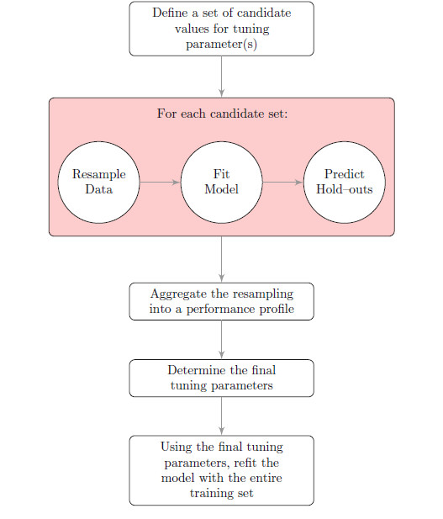

Slide 24
RESAMPLING TECHNIQUES
Resampling is a method that involves repeatedly drawing samples from the training dataset.
These samples are then used to refit a specific model to retrieve more information about the fitted model
The aim is to gather more information about a sample and improve the accuracy and estimate the uncertainty.
For example, if you’re looking at linear regression fits and want to examine the variability.
You will repeatedly use different samples from the training data and fit a linear regression to each of the samples.
This will allow you to examine how the results differ based on the different samples, as well as obtain new information.
The significant advantage of resampling is that you can repeatedly draw small samples from the same population till your model achieves its optimum performance.

Slide 25
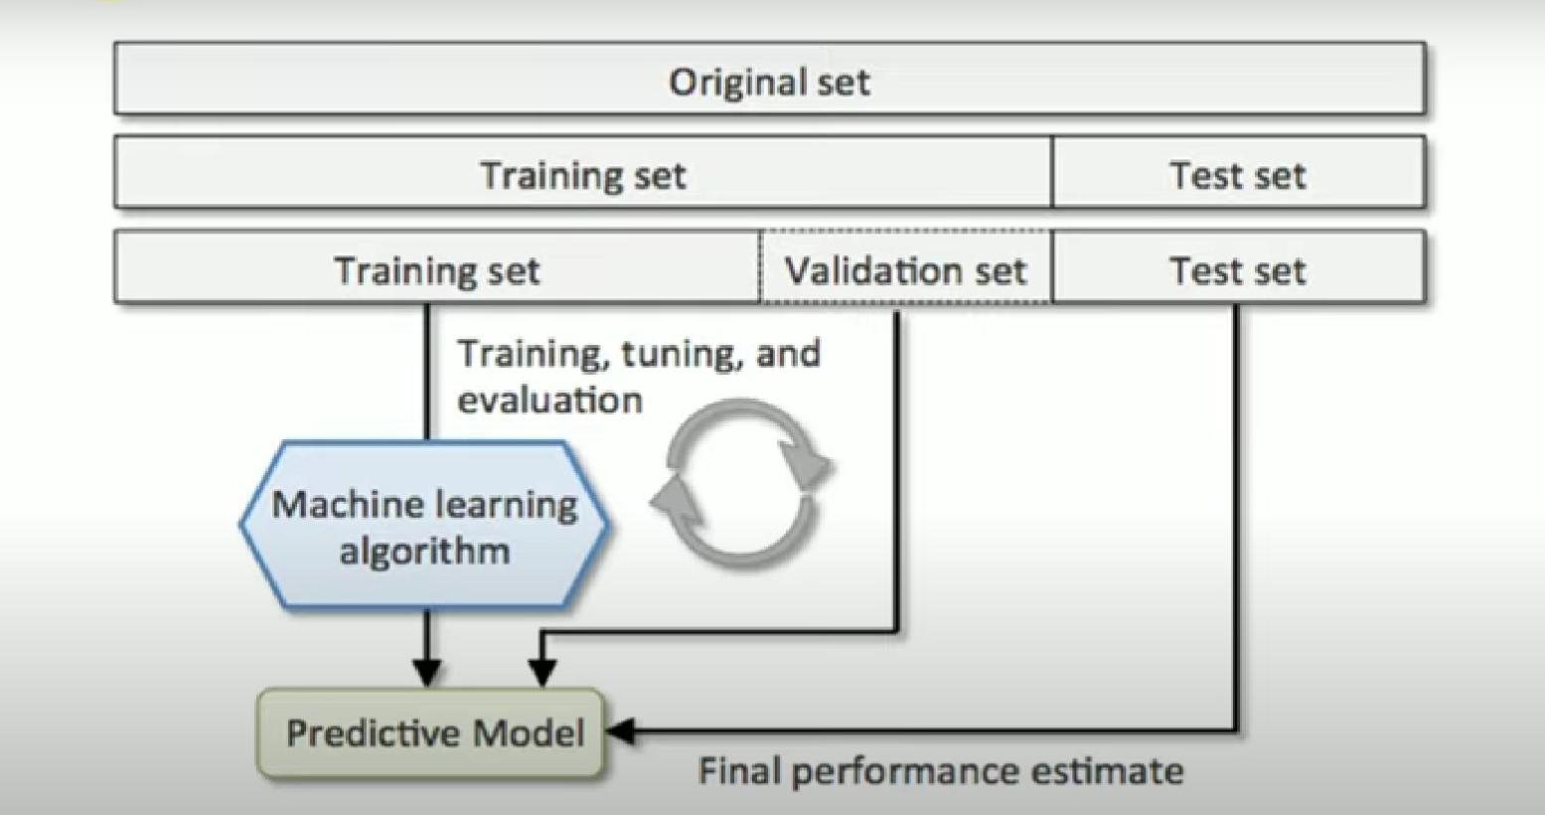
CROSS VALIDATION

Slide 26
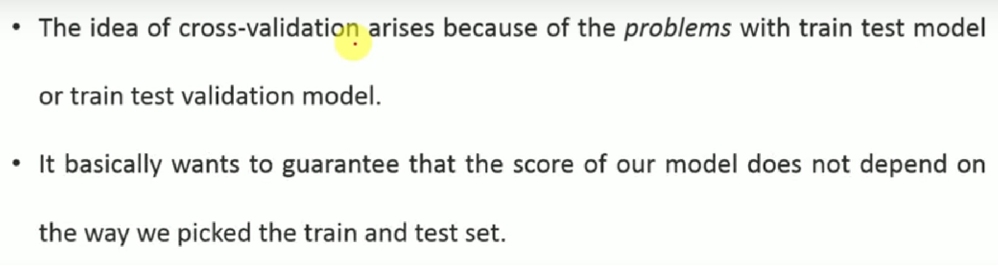

Slide 27
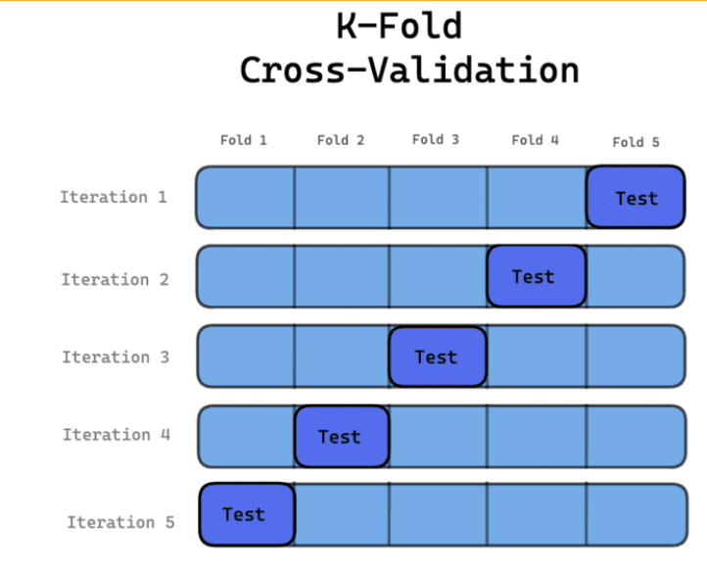
K-FOLD CROSS VALIDATION

Slide 28
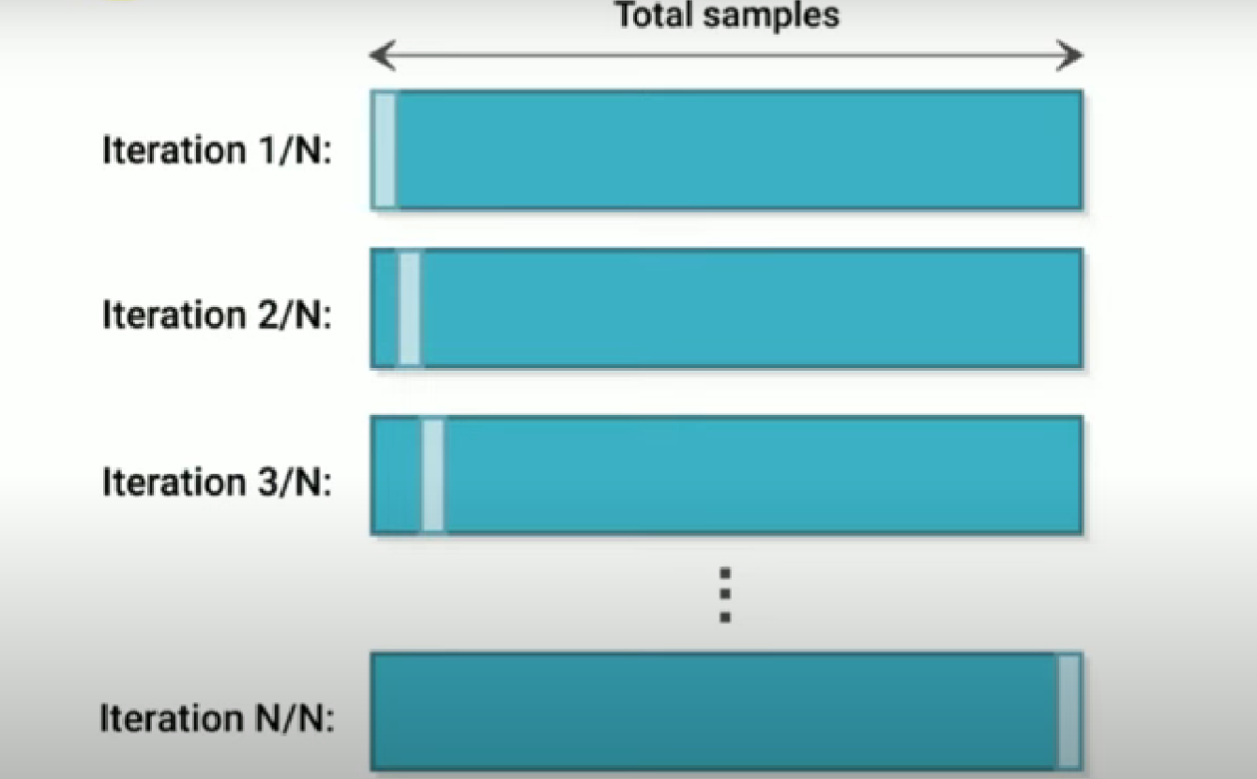
LEAVE-ONE-OUT CROSS VALIDATION

Slide 29
Bootstrap Method
The Bootstrap method can be applied to examine the hidden information and distribution of the data set.
When using the bootstrapping method, the samples that are drawn are replaced and the data that are not included in the samples are used to test the model.
It is a flexible statistical method that can help data scientists and machine learning engineers quantify uncertainty.
The process includes
Repeatedly drawing sample observations from the dataset
Replacing these samples to ensure the original data set stays at the same size.
An observation can either appear more than once or not at all.

Slide 30
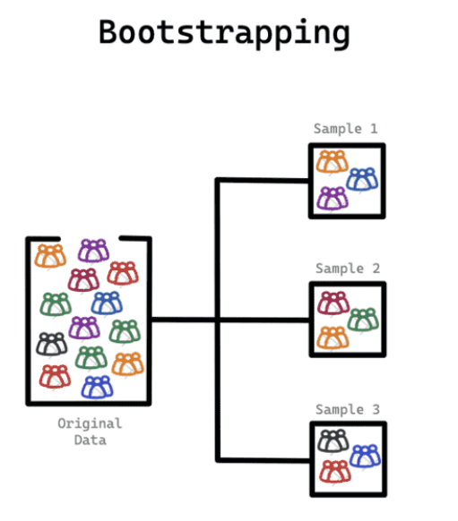
BOOTSTRAPPING

Slide 31
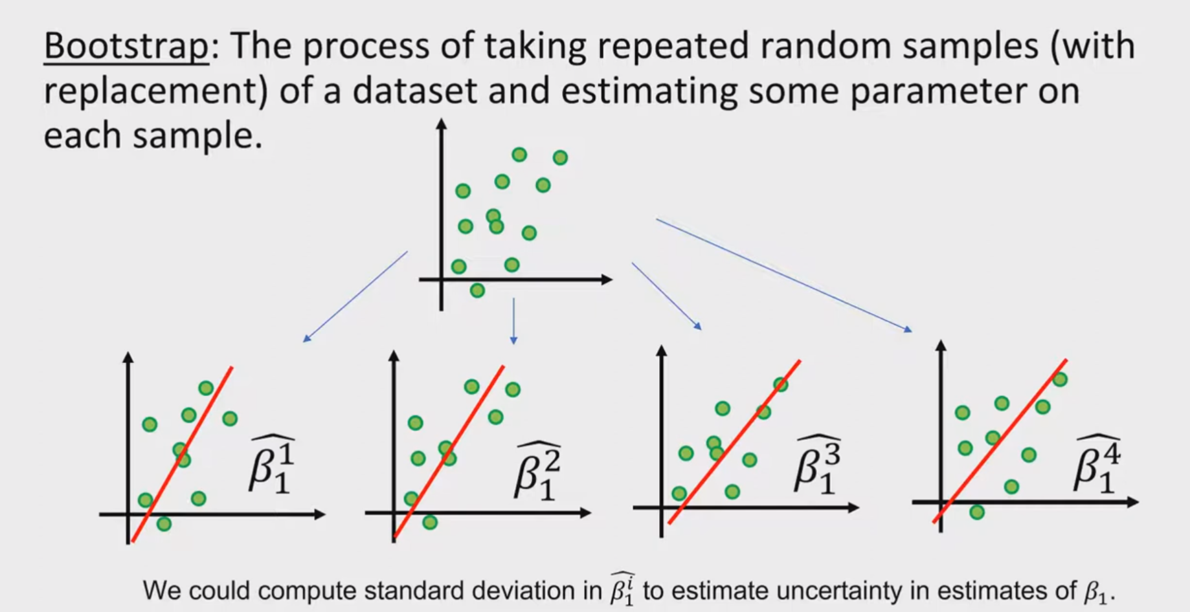

Slide 32
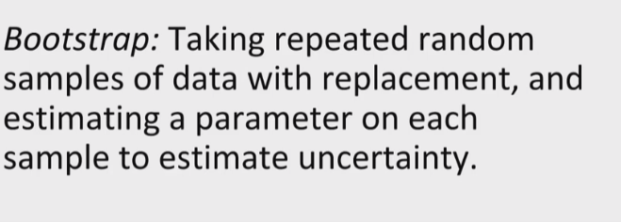
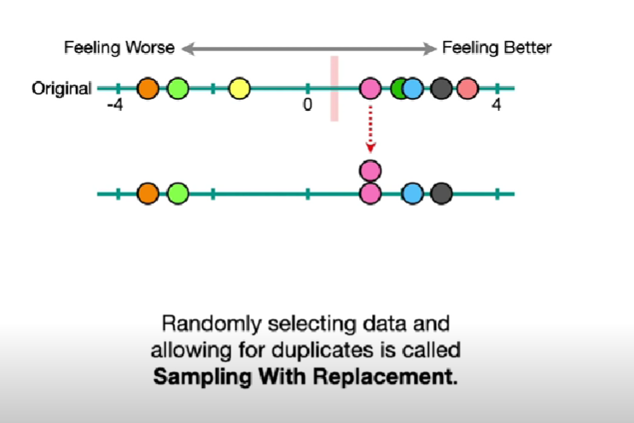

Slide 33
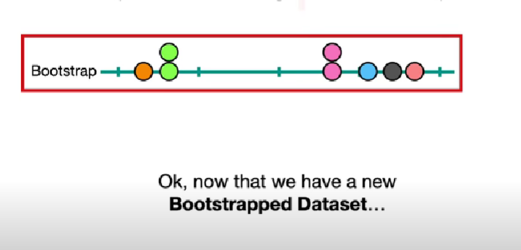

Slide 34
